Slide 1
EDA Assignment 5 Part 1
5420 Anomaly Detection, Fall 2020
- Harsh Dhanuka, hd2457

Slide 2
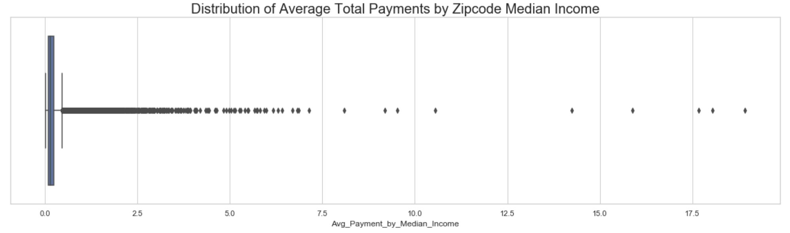
5420 Anomaly Detection, Fall 2020
- Harsh Dhanuka, hd2457
Initial Approach
Created 3 New Features
In addition to the 14 features I engineered previously, I created some new features based on the ideas I captured from viewing the videos of my peers at the discussion board last week:
- Sum total of Total Discharged grouped by the Provider Id and Provider Name
Further, I added the ‘population’ dataset, which contains the median income and population per zip code and created these 2 new features:
Ratio of Average Total Payments to Zip Median Income
Ratio of Total Discharges to Zip Population

Slide 3
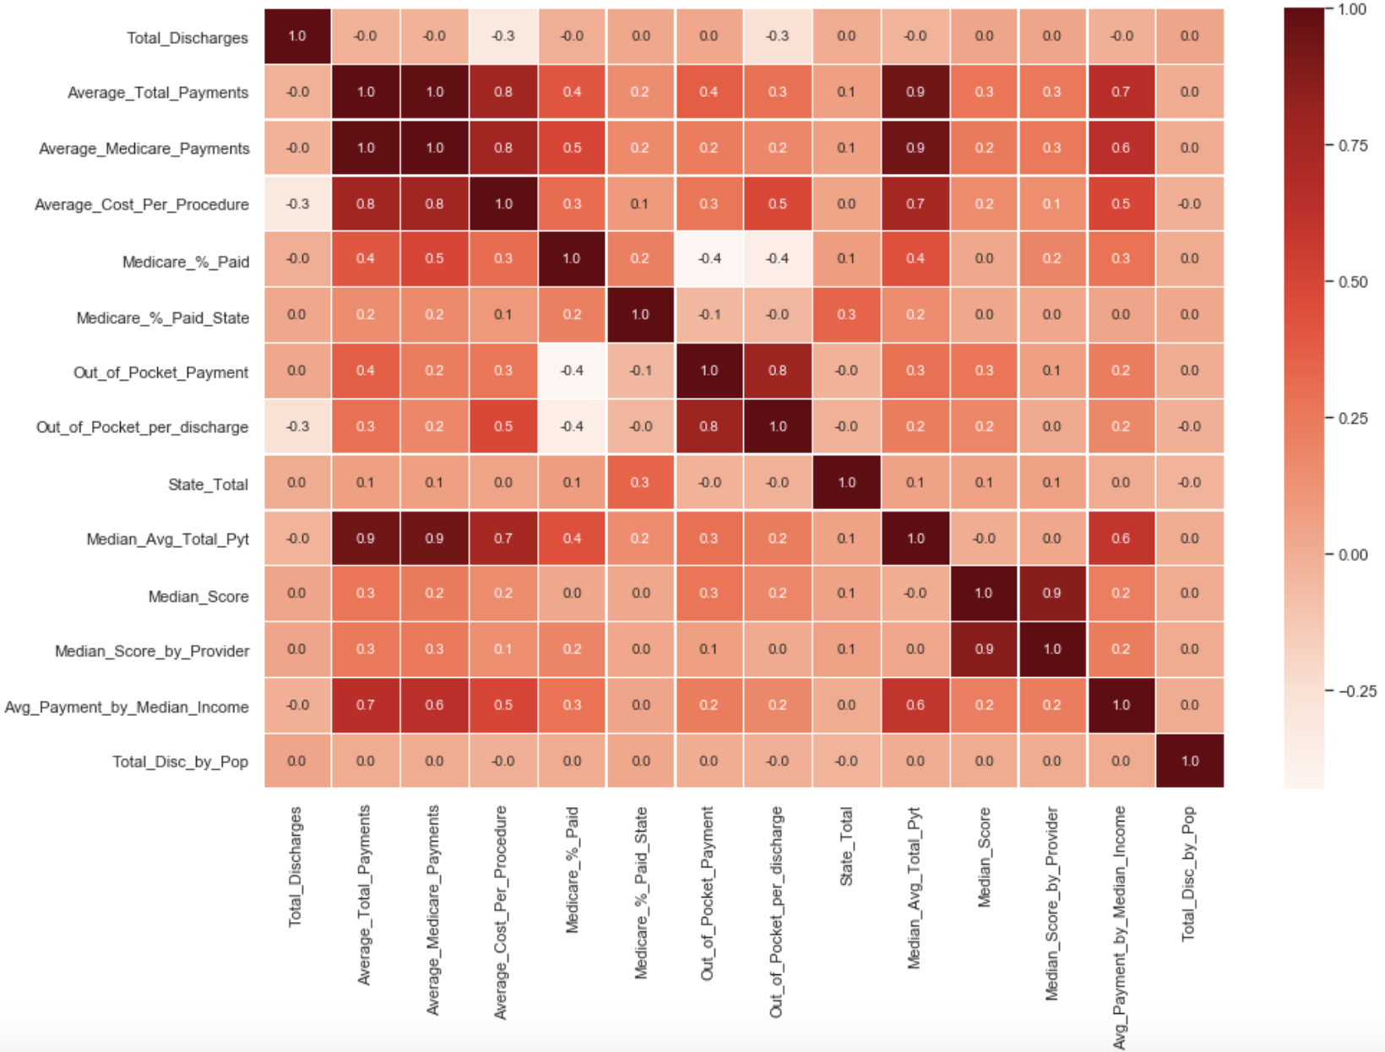
5420 Anomaly Detection, Fall 2020
- Harsh Dhanuka, hd2457
kmeans Clustering
Heatmap for multi-collinearity
Considerations:
Impute missing zip code population/income data with median
Categorical Variables – drop all of them, as kmeans is not ideal with a one-hot encoded categorical variables. Also, I have already created new features using the categorical variables.
Check multi-collinearity, drop a variable from a pair which has a ratio over 0.7
Standardize 14 final numeric variables to be used for kmeans clustering

Slide 4
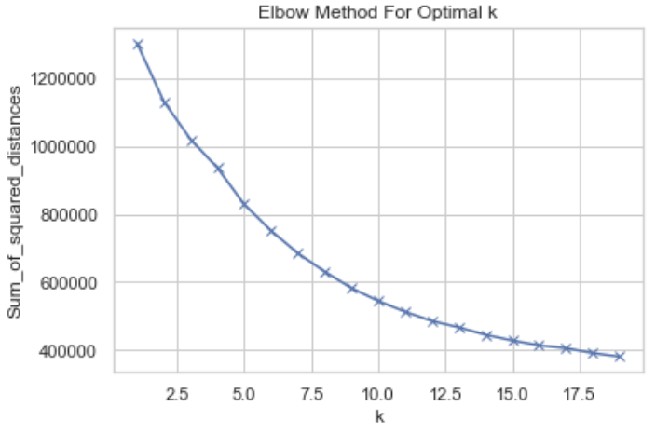
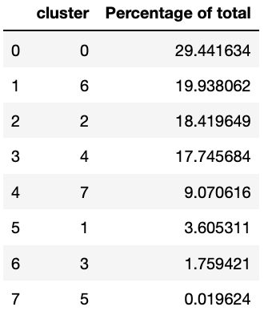
5420 Anomaly Detection, Fall 2020
- Harsh Dhanuka, hd2457
kmeans Clustering
1
Model
Build a kmeans model for k in range (0,20)
2
Optimal k
It is common to get an elbow(s) around k = 2-5 However, I have decided to take an optimal k of 8, which is because on performing the kmeans on a range of 5-10, I see a small elbow at k = 8
3
Evaluate the clusters
Check the percentage of total data in each cluster, based on the over 163k total data points
Consider those with less than 5% of total data as suspicious, perform further investigation

Slide 5
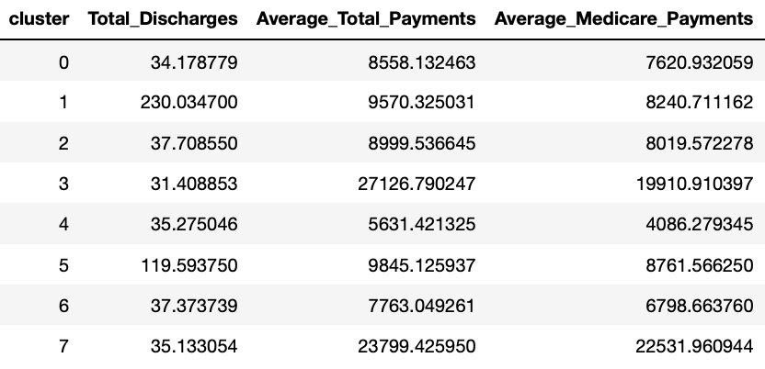
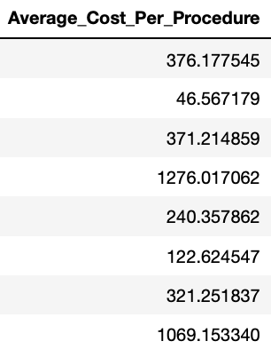
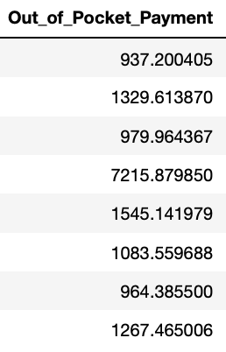
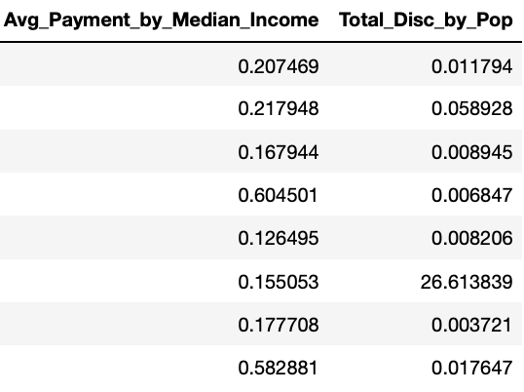
5420 Anomaly Detection, Fall 2020
- Harsh Dhanuka, hd2457
Cluster Evaluation
Cluster wise variable Averages
1
Clusters 1, 3 and 5 which had less than 5% of the total data points
They have extremes or high standard deviation from mean for some variables, and hence, I will still consider them as suspicious. Feature-wise cluster EDA will be imperative to justify this claim.
2
Cluster 7
This cluster also has extremes or high deviation from mean, but, this cluster contains roughly 10% of the total data points. Hence, this doesn’t seems as an outlier. Rather, its a more expensive treatment or state.

Slide 6
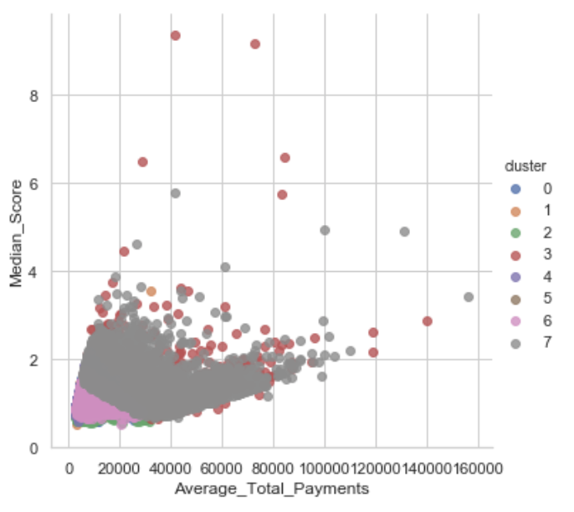
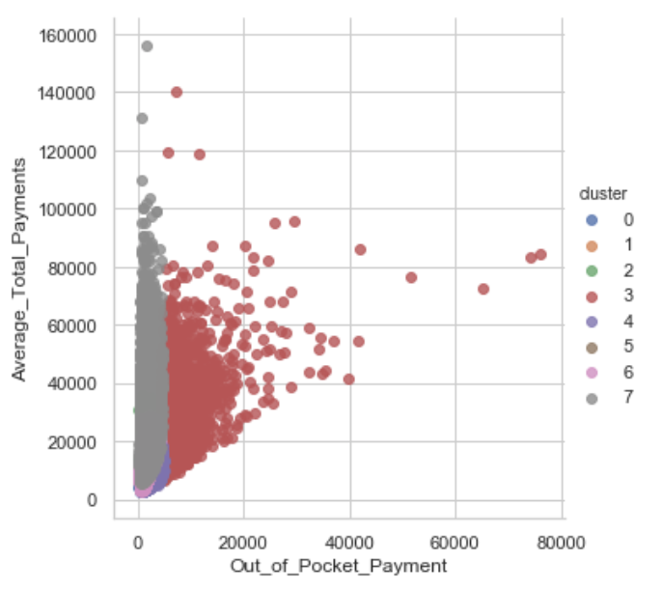
5420 Anomaly Detection, Fall 2020
- Harsh Dhanuka, hd2457
Clustering EDA
Average Total Payments by Median Score
2
Out of Pocket Payment by Average Total Payments
1

Slide 7
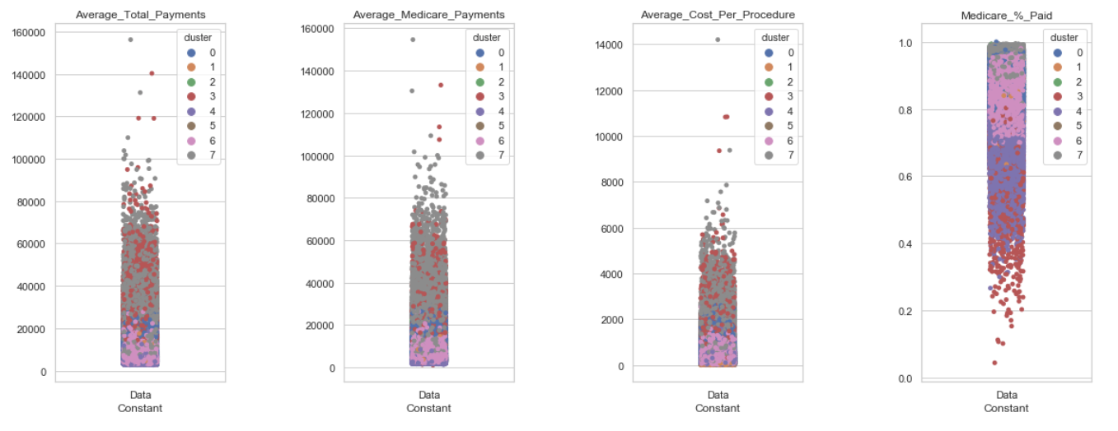
5420 Anomaly Detection, Fall 2020
- Harsh Dhanuka, hd2457
Clustering EDA
3
Plot all the 14 variables to see cluster wise distribution

